Slide 1
Medium Access Control
Unit 3

Slide 2
Network links: p2p and broadcast link
LANs are broadcast (WANs are P To P)
Key issue is who will go next, who will get channel
Broadcast channels are called multi-access or random access channels
Problem is: How to allocate Channel
Needs a protocol to decide who will go next

Slide 3
Channel Allocation Problem
Static Channel Allocation:
FDM: Example; FM radio stations.
When there is small and constant users, each of which has steady stream or a heavy load of traffic; this scheme is simple and efficient allocation mech.
For large no of senders or traffic is bursty, FDM presents some problem.
If some user communicating; wastage of BW
If large no; access denied (lack of BW)

Slide 4
Even if managed no of user to be constant (N), the problem is when users are inactive their BW is wasted since no one is allowed to use.
A static allocation is poor in which data traffic is extremely bursty. Consequently most of the chs will be idle most of the time.
Static ch allocation doesn’t works well with bursty traffic.

Slide 5
Dynamic Ch Allocation
Assumptions:
Independent Traffic
N independent stations; λΔt frames; Once a frame been generated, the station is blocked and does nothing until the frame transmitted successfully.
Single CH.:
All station can send and receive from it; stations are of equal capable but may be assigned diff roles through protocols
Observable Collisions:
If 2 frames are transmitted simultaneously, they overlap in time -> garbled; collision. All Stations can detect collision; retransmits.
Continuous or slotted time:
Sending frame any time or at start of slot; Slot may contain 0,1 or more frames-> idle, success, collision.

Slide 6
Carrier Sense or No Carrier Sense:
Carrier sense: stations can tell if ch is in use b4 trying. No station attempt to use if sensed busy.
No carrier sense: Cant sense b4 trying, just sends and can determine whether is was successful transmission.
Note: No Multiaccess protocol guarantees reliable delivery. Even in absence of collisions, the receiver may receive frames in-correctly for various reasons.

Slide 7
Multiple Access Protocol
ALOHA: Pure and Slotted
Pure ALOHA
The basic idea is simple, let users transmit whenever they have data to send.
In ALOHA, after each station has sent its frame to central computer, this comp rebroadcast the frame to all of the stations.
If the frame was destroyed, the sender just waits a random amount of time and sends it again.
The frames are of same length. (for max throughput)
When frames collide, they will garbled.

Slide 8
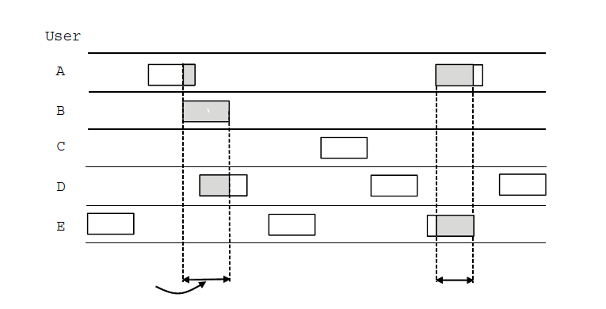
In pure ALOHA, frames are transmitted at completely arbitrary times

Slide 9

Maximum throughput occurs at G=0.5,
S=1/2e
S=0.184
=> 18%

Slide 10
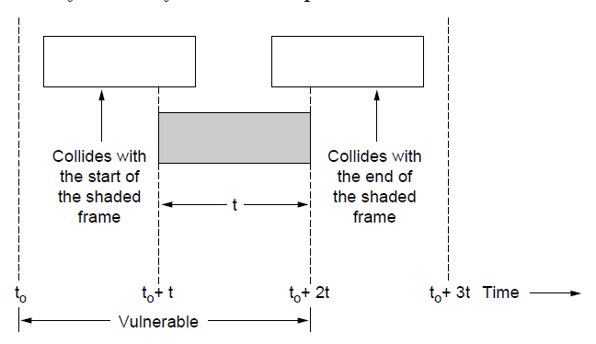
Vulnerable period for the shaded frame.

Slide 11
Slotted ALOHA
Roberts(1972) published a method for doubling the capacity of an ALOHA System.
His proposal was to divide time into discrete intervals called slots; each interval corresponding to one frame.
This approach requires the users to agree on slot boundaries.
Needs a special station that emits a pip at the start of each interval, like a clock.
So station cant sends the frame when its ready, but needs to wait for the beginning of the next slot. This halves the vulnerable period.

Slide 12

Maximum throughput occurs at G=1,
S=1/e
S=0.368
37%
[37% idle, 37%success, 26%collision]

Slide 13
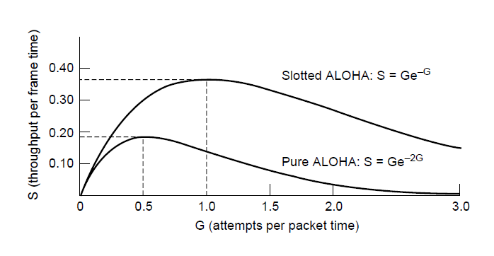
Throughput versus offered traffic for ALOHA systems.

Slide 14
Carrier Sense Multiple Access Protocols: Protocols in which the stations listen for a carrier (i.e transmission) and act accordingly are called carrier sense protocols.
Persistent and Nonpersistent CSMA
1-persistent:
When a station has data to send, it first listens to the ch. to see if anyone else is transmitting at that moment. If ch is idle, the stations send the data. Or else waits until its becomes idle.
If a collision occurs, the station waits a random amount of time and starts all over again. The protocol is called as 1-persistent since the station transmits with probability of 1 when it finds ch is idle.
Notes:
For 1-persistent, there is collision if 2 stations waiting in the middle of 3rd being transmitting currently, and both sends immediately when ch is idle.

Slide 15
ii. Nonpersistent:
In this protocol, a conscious attempt is made to be less greedy than in the previous one. Instead of sending immediately upon detecting the end of previous transmission, it waits for random period of time and then repeats the algorithm.
Consequently, this algo leads to better ch utilization but longer delays than 1-persistent CSMA.
iii. P-persistent CSMA:
It applies to slotted chs.
When a station becomes ready to send, it sense the ch. If it is idle, it transmits with the probability p. With a probability q = 1-p, it defers(postpone) until nxt slot. If that (nxt) slot is also idle, it may transmit or defers.
If stations sense the ch busy, it waits until the nxt slot and applies the above algo.
IEEE 802.11 uses a refinement of p-persistent CSMA.
Notes:
Conscious: aware of and responding to one's surroundings

Slide 16
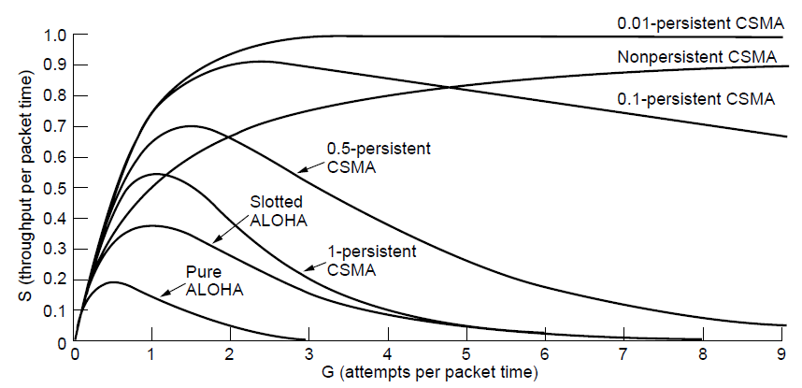
Comparison of the channel utilization versus load for various random access protocols.

Slide 17
CSMA with Collision Detection
If two stations sense the ch is idle and begin transmission simultaneously, their signal is still going to collide.
An improvement could be to quickly detect and stop the transmission(rather than finishing them) since they are going to be garbled anyway.
This strategy saves time and BW.
This protocol, known as CSMA/CD (Carrier Sense Multiple Access with Collision Detection), is the basis of classic Ethernet LAN.
Minimum time to detect collision = time for signal to propagate.
CSMA/CD can be in one of three states: transmission, contention, or idle

Slide 18
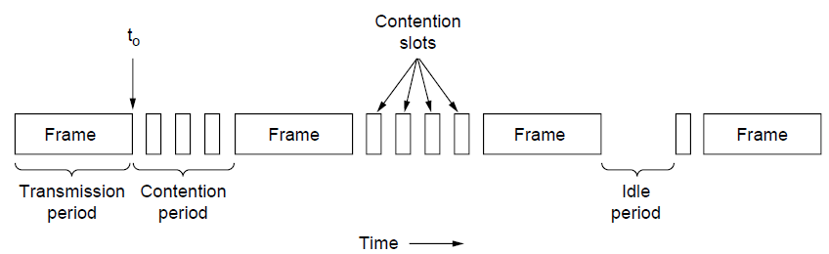
CSMA with Collision Detection
CSMA/CD can be in one of three states: contention, transmission, or idle.

Slide 19
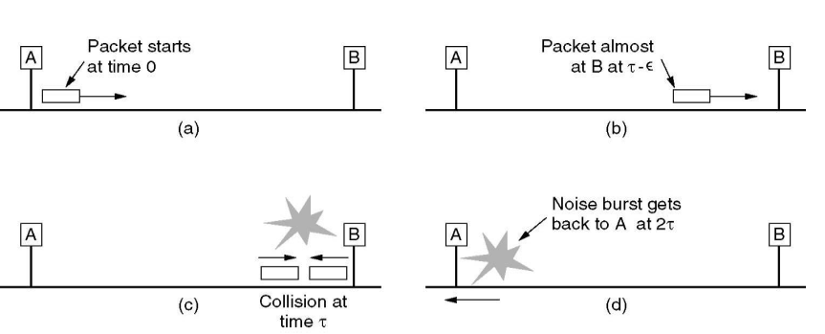

Slide 20
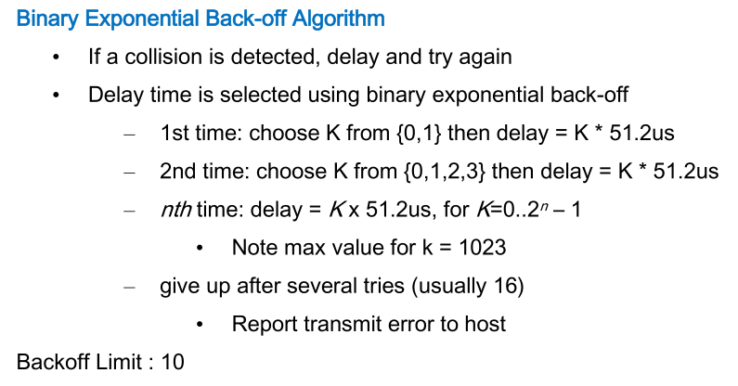
CSMA/CD with Binary Exponential Backoff

Slide 21
Collision Free Protocol
The collision in contention period in CSMA/CD adversely affect the system when delay-BW product is large, such as the cable is long and frames are short. This is not good for real-time traffic as VOIP.
Collision Free : No collision [not even during contention period]
Bit-Map
Token Ring
Binary Countdown

Slide 22
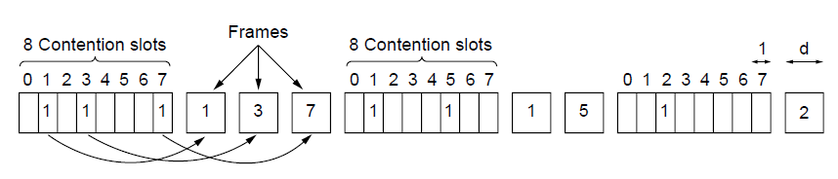
A Bit-Map Protocol
The basic bit-map protocol.

Slide 23
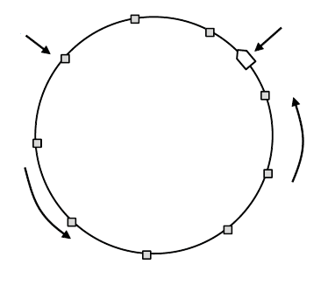
Token Ring
No bias for low- or high-numbered stations.
Token ring.

Slide 24
Binary Countdown Protocol
All stations have same length binary address
Station wanting to use channel now broadcasts its binary address string starting with MSB
Bits from all address of stations wanted to transmit are ORed.
Stations will get chance according to 1st position from MSB to LSB

Slide 25
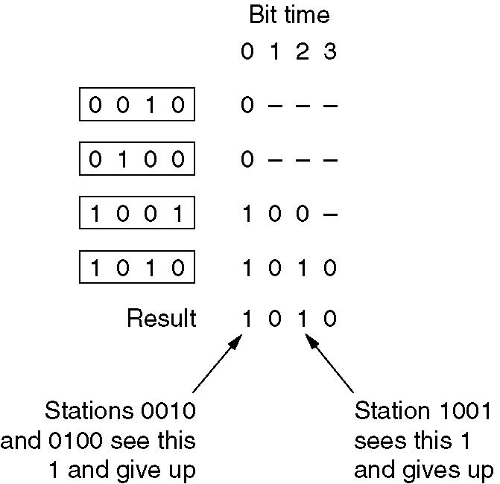
“-“dash => indicates the silence

Slide 26
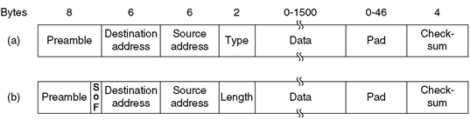
Classic Ethernet MAC Sublayer Protocol
Frame formats. (a) DIX Ethernet, (b) IEEE 802.3

Slide 27
Preamble: 8B; each containing 10101010(except the last byte last 2bits as 11) This last byte is called as Start of frame delimiter for 802.3.
Address: 2address, each of 6B long. The 1st transmitted bit of destination address is a 0 for ordinary address and 1 for group addresses[multicasting].Special address consisting of all 1bits is reserved for broadcasting. Source addresses are assigned by IEEE that are unique globally.
First 3B are used for OUI[Org Unique Id], and last 3B are assigned by manufacturer. Thus 6B address are programed in NIC.

Slide 28
Type/Length: [Whether Ethernet or 802.3]. Ethernet uses type field to tell the receiver what to do with the frame. (eg 0x0800 -> IPv$4). IEEE 802.3 uses this field to carry length of the frame.
Any no less than 0x600(1536) -> type
Any no grater than 0x600 can be interpreted as Length.
Data: 1500B.
Min length 64B from Dest. add to checksum.
6+6+2+v+4=64; => D+padd=46B
Checksum: 32bit CRC

Slide 29
Wireless LAN Protocol
A system of laptop that communicates using radio can be regarded as wireless LAN. Such a LAN is an example of broadcast ch.
It has different props than wired LAN hence different MAC protocol.
The CSMA approach is not good for wireless bcoz interference is at receiver and not sender.

Slide 30
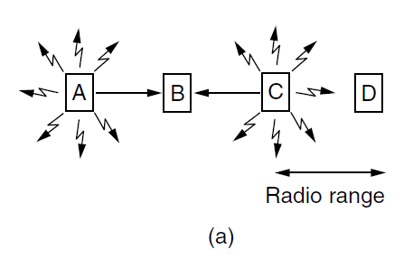
Problems:
Refer fig, The radio range is such that A and B are within each others range and can potentially interfere with one another. C can also potentially interfere with both B and D, but not with A.
A wireless LAN. (a) A and C are hidden terminals when transmitting to B.

Slide 31
1. What happens when A and C transmit to B.
If A sends and immediately C senses the medium, it will not hear A, since not in range.
Thus C falsely conclude that it can send to B.
If C sends transmitting , it will interfere at B.
We want a MAC protocol that will prevent this kind of collision from happening bcoz it will waste the BW.
The problem of a station not being able to detect a potential competitor for the medium bcoz its too far away is called the hidden terminal problem

Slide 32
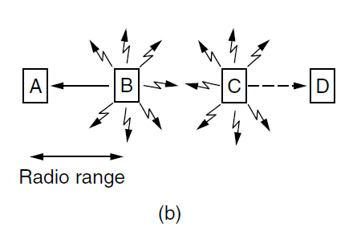
A wireless LAN. (b) B and C are exposed terminals when transmitting to A and D.

Slide 33
2. B transmitting to A at the same time that C wants to transmit to D.
If C senses the medium, it will hear a transmission (from B) and falsely conclude that it may not send to D(dotted lines in fig).
Such a transmission would cause bad reception only in the zone between B and C, where neither of the intended receivers is located.
We want a MAC protocol that prevents this kind of deferral from happening bcoz it will waste the BW.
The problem is called the exposed terminal problem.

Slide 34
The difficulty is that, before starting a transmission, a station really wants to know whether there is radio activity around the receiver. CSMA merely tells it whether there is activity near the transmitter by sensing the carrier.
In a systems based on short-range radio waves, multiple transmissions can occur simultaneously if they all have different destination.
We want this concurrency to happen as the cell gets larger and larger.
The protocol that tackles these problems for wireless LANS is called MACA (Medium access with Collision Avoidance): The ides is for the sender to simulate the receiver into outputting a short frame, so stations nearby can detect this transmission and avoid transmitting for the duration of the upcoming (large ) data frame. This technique is used instead of carrier sense.

Slide 35
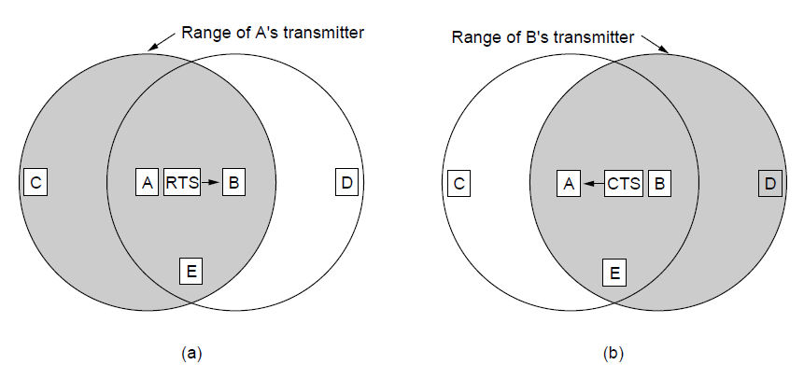
The MACA protocol. (a) A sending an RTS to B. (b) B responding with a CTS to A.

Slide 36
1. A sends frame to B.
A starts by sending an RTS frame to B.
This short frame(30B) contains the length of the data frame that will eventually follow.
Then B replies with a CTS frame.
The CTS frame contains the data length(copied from RTS).
Upon receipt of the CTS frame, A begins transmission.
Now lets see how stations overhearing either of these frames react.
Any station hearing RTS is clearly close to A and must remain silent long enough for the CTS to be transmitted back to A without conflict.
Any station hearing CTS is clearly close to B and must remain silent during the upcoming data transmission, whose length it can tell by examining the CTS frame

Slide 37
C is within range of A but not in range of B.
C hears RTS from A and not CTS from B.
As long as it does not interfere with CTS, it is free to transmit while the data frame is being sent.
In contrast, D is within the range of B and not A.
D hears CTS but not RTS.
Hearing the CTS tips it off that it is close to a station that is about to receive a frame, so it defers sending anything until that frame is expected to be finished.

Slide 38
Despite these precautions, collisions can still occur.
If B and C could send RTS frames to A at the same time. These will collide and be lost.
In the event of a collision, an unsuccessful transmitter (i.e one that does not hear CTS within the expected time interval) waits a random amount of time and tries again later.

Slide 39
802.11 architecture
Infrastructure and Ad-Hoc Modes
Most Wi-Fi networks function in infrastructure mode. Devices on the network all communicate through a single access point, which is generally the wireless router. For example, let’s say you have two laptops sitting next to each other, each connected to the same wireless network. Even when sitting right next to each other, they’re not communicating directly. Instead, they’re communicating indirectly through the wireless access point. They send packets to the access point — probably a wireless router — and it sends the packets back to the other laptop. Infrastructure mode requires a central access point that all devices connect to.
Ad-hoc mode is also known as “peer-to-peer” mode. Ad-hoc networks don’t require a centralized access point. Instead, devices on the wireless network connect directly to each other. If you set up the two laptops in ad-hoc wireless mode, they’d connect directly to each other without the need for a centralized access point.

Slide 40
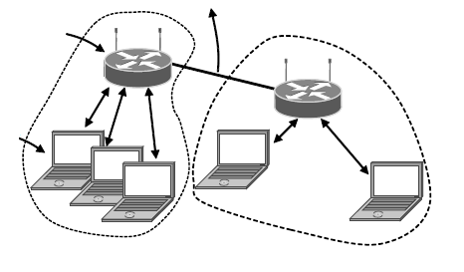
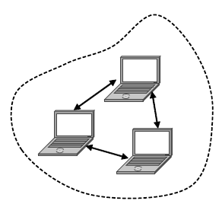
802.11 architecture – infrastructure mode
802.11 architecture – ad-hoc mode

Slide 41
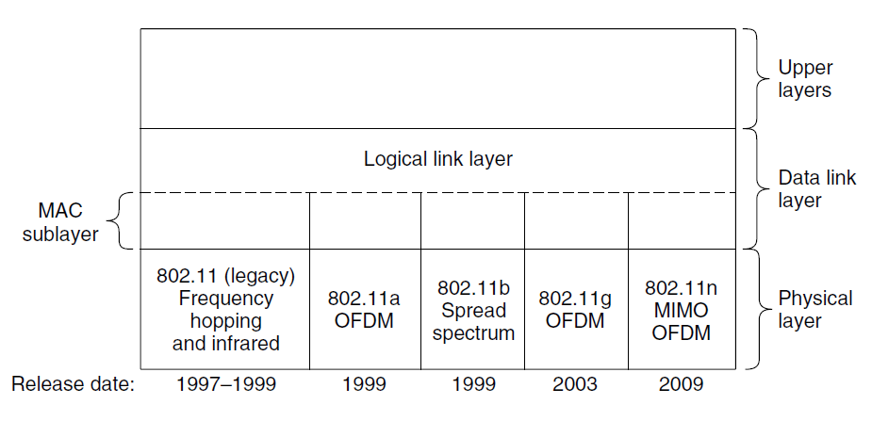
Part of the 802.11 protocol stack.

Slide 42
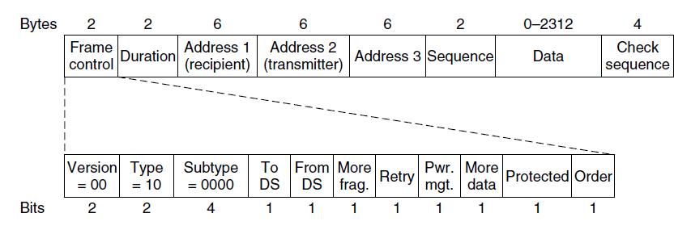
Format of the 802.11 data frame

Slide 43
802.11 defines 3 classes of frames : data, control and management.
Data frame:
Frame control: 11 subfields.
Protocol ver: 00
Type: Data, control or management
Subtype: RTS or CTS
To/from DS: frame is going to or coming from the network connected to APS.
More frag: more fragments will follow.
Retry: retransmission of a frame sent earlier.
Pwr mgt: Sender is going into power saving mode.
More data: Sender has additional frames for the receiver.
Protected: frame body is encrypted for security.
Order: Tells the receiver that the higher layer expects the seq of frames to arrive strictly in order.

Slide 44
Duration: Tells how long the frame and its ack will occupy the ch.[in microsecs]
Address: 3 address
Receiver
Transmitter
AP
Seq: dup can be detected
Data: payload of 2312B
FCS: 4B CRC
Management frames have same format as data frames, plus a format for data portion that varies with subtype.
Control frames are short.
Frame control, Duration, FCS and one address and no data portion. Most of the key info is conveyed with subtype (ACK, RTS, CTS)

Slide 45
Wavelength Division Multiple Access
Using FDM, TDM or both channel allocation is achieved.
Similar approach is used in fiber optics where conversations take place on different wavelength at same time.
To allow multiple transmission at same time, the spectrum is divided into channels(wavelength bands).
In WDMA, each station is assigned two chs; a narrow band ch is provided as a control ch to signal the station, and a wide ch is provided so that station can output data frames.

Slide 46
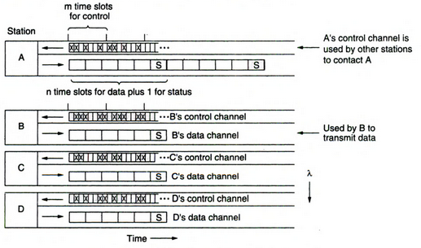

Slide 47
Each ch is divided into grps of time slots. m slots for control and n+1 for data; [+1 is for status(which ch on both slots are free)]. All chs are synchronized by single global clock.
The protocol supports three traffic classes:
Constant data rate connection oriented, such as uncompressed video.
Variable data rate connection oriented, such as file transfer.
Datagram traffic, such as UDP packets.
For connection oriented, say A wants to communicate to B. Then A must first insert a CONNECTION_REQUEST frame in free slot on B’s control ch. If B accepts, commn takes place on A’s data ch.
Each station has two transmitter and two receivers.

Slide 48
Example
A picks one of the free control slots, say 4, and insert CR msg there.
Since B constantly monitors its control ch, it sees the request and grants slot 4 to A.
This assignment is announced in the status slot of B’s data ch.
When A sees the announcement, it knows it has unidirectional connection.
If A asked for a two-way connection, B now repeats the same algorithm with A.
If say C tries for slot 4 of B at same time, Neither A nor C will get it, and both will notice failure by monitoring the status slot in B’s control ch.
Then each wait random amount of time and try again.

Slide 49
IEEE 802.3 10Mbps Ethernet
Name | Cable | Max seg (m) | Nodes/seg | Diameter | Advantages
10base5 | Thick cox (50ohm) | 500 | 100 | 0.4’’ | Org cable, now obsolete
10base2 | Thin cox (50ohm) | 185 | 30 | 0.25’’ | No hub needed
10base-T | Twisted Pair | 100 | 1024 | 0.5mm | Cheapest
10base-F | Fiber optics | 2000m | 1024 | 62.5/125 um | Best between buildings
Manchester Encoding

Slide 50
802.11 Protocol Stack

Slide 51
802.11 Infrared
• Uses IR diodes
• Diffuse light(not line of sight)
• Multiple reflections (walls, furniture etc.)
• Transmission at 0.85 microns or 0.95 microns
• Speeds : 1 Mbps and 2 Mbps
Advantages
• Simple, cheap, available in many mobile devices
• No licenses needed
• Simple shielding possible
Disadvantages
• Interference by sunlight, heat sources etc.
• Many things shield or absorb ir light
• Low bandwidth
•Cannot penetrates the walls

Slide 52
802.11a High Speed WLAN using OFDM
(Orthogonal Frequency Division Multiplexing)
• Operates in the 5.15GHz to 5.35GHz radio spectrum.
• Speed: Up to 54Mbps (actual throughput is closer to 22Mbps)
• Range: 50 feet
• Less prone to interference.
• More expensive.
• Because 802.11b and 802.11a use different radio technologies and portions of the spectrum, they are incompatible with one another.
• Uses 52 frequencies : 48 for data and 4 for synchronization
• Modulation : PSK QAM

Slide 53
802.11b High Rate DSSS (HR-DSSS) (Wi_Fi Year Mid 1999)
• Point to Multipoint Configuration
• Data rates supported are 1,2,5.5 and 11 Mbps
• 5.9 Mbps over TCP and 7.1 Mbps over UDP
• Uses CSMA/CA
• Range is 7 times grater than 802.11a
• Operates in the 2.4GHz radio spectrum.
• Frequency Bandwidth = 5 GHz
• Range: 100 feet
• Prone to interference
• Least expensive wireless LAN specification.

Slide 54
802.11g OFDM 54 MBps
o Operates in the 2.4GHz radio spectrum.
o Speed: Up to 54Mbps
o Range: 100 feet
o Prone to interference (it shares airspace with cell phones, Bluetooth, security radios, and other devices)
802.11n :
o Operates in the 2.4 or 5GHz radio spectrum
o Speed: Up to 700Mbs
o Range: 50 feet

Slide 55
Bluetooth Architecture
Basic unit is piconet
Piconet consists one master node and 7 active slave nodes
Perimeter is 10 meters
Multiple piconets can be formed via bridge node
Interconnected piconets are called scatternet
Parked slave for responding to the activation/becon from the master.
There can be 255 parked nodes
Uses TDM
Communication between master slave only and not slave to slave
2.4 GHz, FHSS, CDMA
79 channels of 1 MHz each
Modulation FSK, 1-bit per Hz gives 1 Mbps data rate

Slide 56
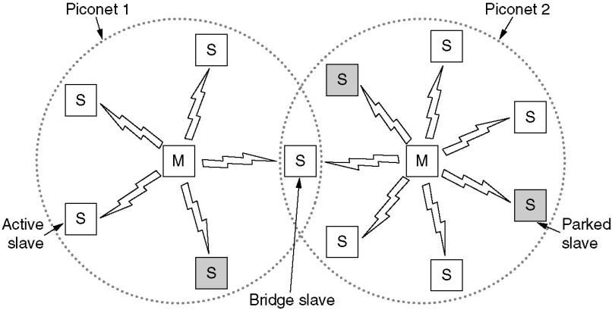

Slide 57
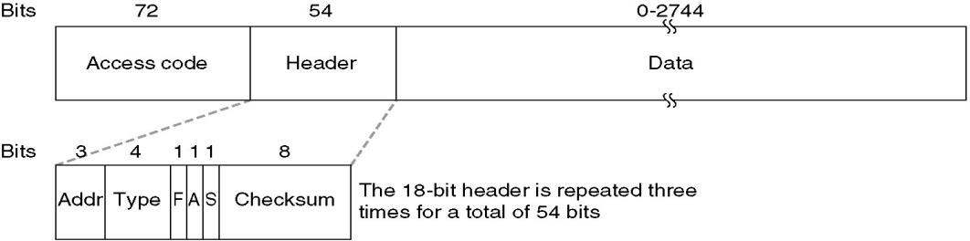
Frame Format
An access code identifies the master so that slaves within radio range of two masters can tell which traffic is for them.
Next comes a 54-bit header containing typical MAC sublayer fields. Then comes the data field, of up to 2744 bits
The Address field identifies which of the eight active devices the frame is intended for.

Slide 58
The Type field identifies the frame type
The Flow bit is asserted by a slave when its buffer is full and cannot receive any more data. This is a primitive form of flow control.
The Acknowledgement bit is used to piggyback an ACK onto a frame.
The Sequence bit is used to number the frames to detect retransmissions. The protocol is stop-and-wait, so 1 bit is enough.
Then comes the 8-bit header Checksum. The entire 18-bit header is repeated three times to form the 54-bit header.

